Slide 1
Seven Golden Use Cases
From design to code

Slide 2
Seven Golden Use Cases
every system on the planet only ever does seven things
  Add create a new unit of data in the system
  Edit update an existing unit of data
  Delete remove a unit of data
  List provide a list
  Find find a single item
  Filter filter the list passed on some sort of pattern matching
  Validate check that data entering the system is correct
Deal with the dull stuff first!

Slide 3
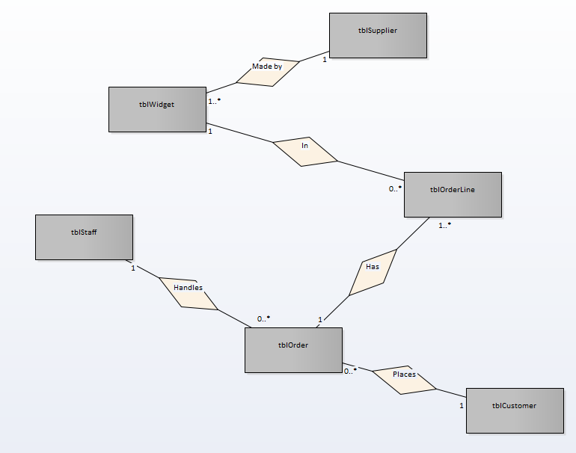
Take a top-level view

Slide 4
Identify the sub systems
  Stock Management tblWidget
  Supplier Management tblSupplier
  Staff Management tblStaff
  Order Management tblOrder – tblOrderLine
  Customer management tblCustomer
Clear this is incomplete!
  Security may not appear on the ERD but likely part of the class diagram
  Shopping cart same as security – likely not part of the ERD
  Stock Purchasing probably should be on the ERD but also raises the issue of Purchase Order and Purchase Order Line

Slide 5
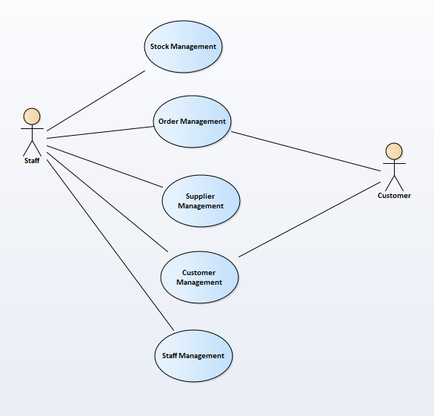
Top Level Use Cases

Slide 6
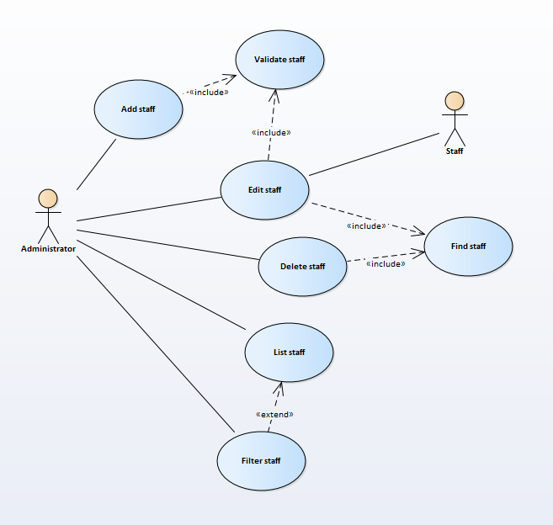
Burrow Down
Here we find the big seven

Slide 7
Issues to consider
Delete
  What happens to the relationships between records if we delete a record between related tables with posted primary and foreign keys?
  This has the potential to break the integrity of the database
  What happens if by law we are required to keep certain data e.g. records of previous employees?
  What happens if by law we must delete some data e.g. the details of customers who no longer wish to be part of the system?

Slide 8
Possible Extensions?
Archive Flag a record as inactive so it doesn’t come up in the main reports?
Unarchive If we can archive records, we need a mechanism to bring the data back
Anonymise Delete important data without deleting the record such that the individual can no longer be identified
Plus others unique to the sub system

Slide 9
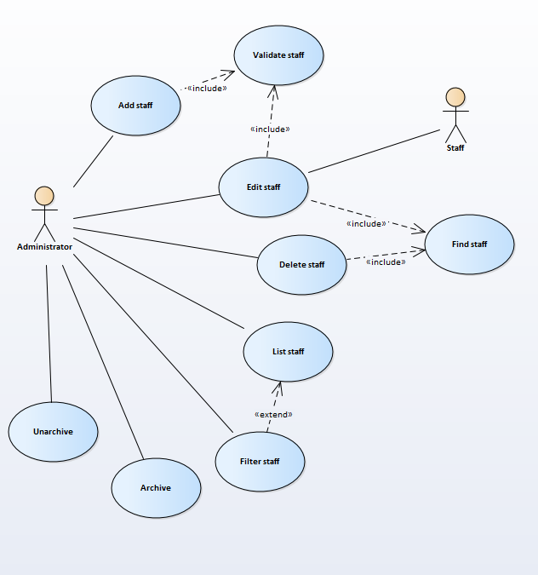
Revised Diagram
Remember – Use case diagrams should be clear to non-technical people!

Slide 10
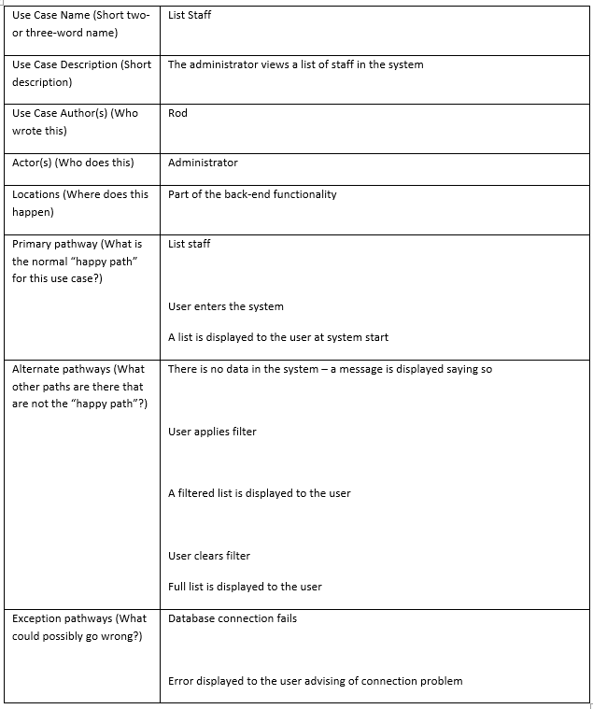
Sample Use Case Description

Slide 11
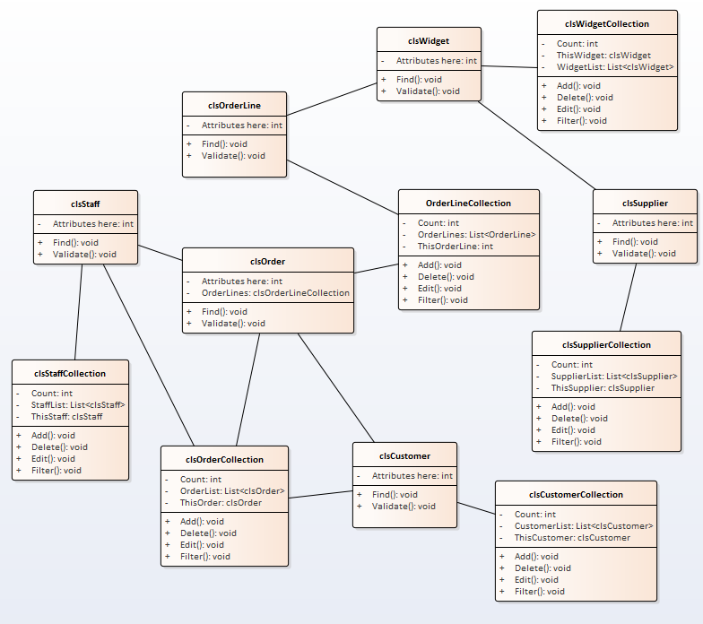
Where is the Functionality?

Slide 12
Issues with Class Diagram
It is simplistic
  clsDataConnection Ignore it. Its inclusion creates associations we don’t care about
  Inheritance this would remove a lot of duplication
  Composition & Aggregation this would allow us to express more nuanced detail
The point is we can write the code for this diagram

